Slide 1
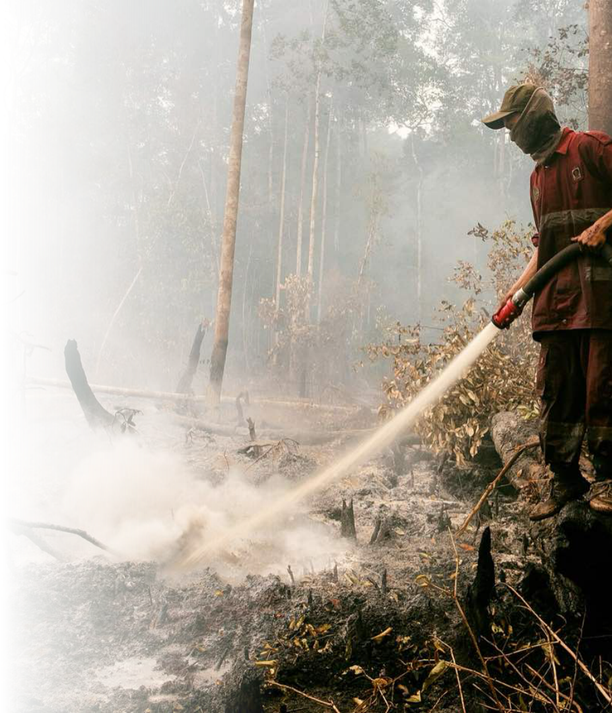


Head of BNPB Meeting with
the Ambassador of Australia
and NSW Rural Fire Service
Indonesia’s 2026 Fire Season and Collaboration with Australia
National Disaster Management Agency (BNPB)
PRESENTED BY
Lieutenant General Kristomei Sianturi, S.Sos., M.Si., M.Si. (Han)
Head of the National Disaster Management Agency (BNPB)
Monday, 26 October 2026
Photo: DenY Krisbiyantoro, CC BY-SA 4.0, Wikimedia Commons

Slide 2






BNPB welcomes Australia’s offer of aerial support and fire expertise to
complement Indonesia’s national response
Key messages
BNPB recorded 197 firespots across 6 priority provinces on 26 October; Indonesia has deployed 39 helicopters and ±71,878 personnel, and welcomes Australian expertise to complement the response.
Disaster response. BNPB has responded to 2,299 events in 2026, including the East Nusa Tenggara earthquake, where 27,563 people are sheltered.
Forest and land fires. 197 firespots recorded by BNPB on 26 October; 6 provinces have activated emergency status to speed up the response.
National response. 39 helicopters, ±71,878 personnel on the ground, and 18 sorties of weather modification; 1,135,000 litres per day dropped.
Australian offer. 2 Citation, 1 King Air, 1 Bell 412, and fire specialists.
HADR airlift. RAAF C-17A, C-130J, C-27J, and KC-30A fleets number 36 aircraft; the KC-30A reaches 14,800 km.
Next steps. Six joint steps, from the specialist offer and asset specifications to research links with BMKG and BRIN.
Source: BNPB DIBI 2026; BNPB forest fire data and daily reports; ADF Capabilities
National Disaster Management Agency (BNPB) | Copyright 2026
2

Slide 3




Indonesia and Australia have worked together on forest fire response since 2015
SUPPORT IN 2015
OFFER IN 2026
2
4
3
Australian aircraft deployed
aerial assets offered
NSW RFS delegation members
Milestones of the partnership
Australian delegation
WHEN
MILESTONE
DETAIL
NAME
ROLE
2015
Forest fire support
"Thor" and "Birddog" aircraft
H.E. Rod Brazier
Ambassador to Indonesia
2015
Australian specialists
Aerial firefighting
Tim Stapleton
Minister Counsellor
Ongoing
InaSAFE
With Australia and World Bank
Paula
Counsellor
Sep 2026
Diplomatic note
Four aerial assets offered
Sep 2026
Foreign Affairs letter
Offer conveyed to BNPB
Leigh Pilkington
Team Leader
Oct 2026
Ministerial Council
Law and Security
Bronwyn Dawn Waters
Incident Management Specialist
Oct 2026
Fire specialist offer
Added to aircraft offer
Rodney Allan Rusden Walker
Incident Management Specialist
Oct 2026
Meeting at BNPB
Ambassador and NSW RFS
PURPOSE OF THE MEETING
Share experience
Discuss support
Align priorities
Incident management and joint firefighting.
Aerial assets and fire specialists for 2026.
Integrated with Indonesia’s command system.
Source: BNPB, October 2026; BNPB Strategic Plan 2025–2029
National Disaster Management Agency (BNPB) | Copyright 2026
3

Slide 4











BNPB has responded to 2,299 events in 2026; forest and land fires account for
1,024 events
DISASTERS IN 2026
548
252,438
165,564
casualties
people displaced
houses damaged
Natural disasters in 2026 by type
TYPE
EVENTS
CASUALTIES
DISPLACED
HOUSES
Forest and land fire
1,024
8
745
280
Flood
581
70
64,624
11,728
Extreme weather
337
23
630
8,072
Drought
122
0
0
0
Landslide
108
160
5,250
1,670
Coastal erosion
14
0
53
270
Earthquake
14
160
174,509
141,492
Volcanic eruption
4
6
650
14
RESPONSE HIGHLIGHTS
Earthquake recovery
Clean water
Fire response
193 transitional housing units being built in East Nusa Tenggara.
Water deliveries reach 44,045 households in Central Java.
19 fire events handled by crews on site.
Source: BNPB DIBI 2026 (provisional); BNPB Daily Disaster Report, October 2026
National Disaster Management Agency (BNPB) | Copyright 2026
4

Slide 5

BNPB recorded 197 firespots across 6 priority provinces on 26 October; 6
provinces have activated emergency status
FIRESPOTS
UNDER ACTIVE RESPONSE
74
28,016
1,407
in South Sumatra, the highest
ha with crews deployed
ha covered by aerial firefighting
Firespots by province
Emergency status activated
Firespots, 26 October 2026
AREA
STATUS
UNTIL
74
1
Central Kalimantan
Response status
29 Oct 2026
2
West Kalimantan
Alert status
31 Dec 2026
3
South Sumatra
Alert status
30 Nov 2026
4
Jambi
Alert status
30 Nov 2026
41
5
East Kalimantan
Alert status
30 Nov 2026
34
6
Riau
Alert status
30 Nov 2026
23
7
Karanganyar
Response status
30 Oct 2026
19
8
Way Kambas NP
Alert status
ongoing
6
9
Wonosobo
Alert status
31 Dec 2026
S Sumatra
S Kalimantan
Jambi
C Kalimantan
W Kalimantan
Riau
Health services and masks are provided to residents in affected cities.
Source: BNPB forest fire data, 26 Oct 2026; BNPB daily reports and operations briefings, October 2026
National Disaster Management Agency (BNPB) | Copyright 2026
5

Slide 6
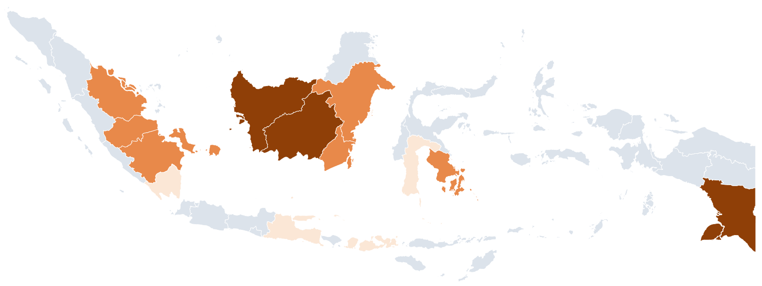

Fire-affected area since January covers about 2,099,692 ha in 14 provinces; crews
are active on ±28,016 ha
Burned and active area by province
PROVINCE
BURNED, HA
ACTIVE, HA
Central Kalimantan
742,664
20,532
West Kalimantan
357,532
1,487
South Papua
315,344
842
South Sumatra
230,181
2,628
East Kalimantan
141,174
597
South Kalimantan
119,336
994
Jambi
38,103
936
Central Kalimantan
Bangka Belitung
35,928
321
South Sumatra
Southeast Sulawesi
35,345
255
Riau
31,414
21
West Nusa Tenggara
29,051
64
South Sulawesi
18,217
170
South Papua
Lampung
2,800
2
East Java
2,603
16
Burned area
Very high
High
Moderate
Boundary source: Pantau Bencana boundary files; WGS84; Equirectangular
Map classes: very high above 300,000 ha; high from 30,000 ha; moderate below.
FIRE SITUATION ON THE LATEST DAY
Central Kalimantan
Tanjung Puting National Park
Daily report
±20,532 ha covered by ground and aerial crews.
±1,407 ha handled by aerial firefighting.
19 fire events recorded, with crews on site.
Source: BNPB Daily Disaster Report, October 2026
National Disaster Management Agency (BNPB) | Copyright 2026
6

Slide 7





















Forest and Land Fire Operations as of 24 October 2026
71,878 ground personnel, 63 aircraft, and cloud seeding in 3 provinces with rain reported in 6 provinces
RESPONSE
13,396 20%
PERSONNEL BY PROVINCE
Military
8,950 14%
Private
4,749 7%
Community
71,878
39
24
11,231 17%
C Kalimantan
16,387 23%
Riau
14,837 21%
W Kalimantan
14,458 20%
BPBD
8,201 13%
Volunteers
2,031 3%
Forestry
10,446 16%
Police
4,767 7%
Local govt
1,758 3%
ground personnel
WB helicopters
patrol/OMC aircraft
M. Agni
S Sumatra
12,285 17%
S Kalimantan
7,927 11%
Jambi
5,984 8%
WEATHER MODIFICATION
AIRCRAFT
24 Oct
63 units
24 patrol/CASA/OMC
39 WB helicopters
RAIN AFTER SEEDING
24 Oct
rain in 4 of 4 provinces
SEEDING TARGETS
RESULT
South Kalimantan
9
6
15 units
West Kalimantan
No seeding flown
MODERATE RAIN
South Sumatra
10 units
in Kapuas Hulu, 24 Oct (no seeding)
5
5
Central Kalimantan
Palangka Raya, Katingan, Pulpis, Kotim, Kobar
HEAVY RAIN
Central Kalimantan
2
8
10 units
in Seruyan, 24 Oct
West Kalimantan
2
7
9 units
South Sumatra
Palembang, Banyuasin, OKI, Muba
RAIN
in Muba, Palembang, Banyuasin, OKI
Riau
1
4
5 units
South Kalimantan
Tala, Kotabaru, Batola, Tapin, HSS, HSU, Balangan
RAIN
Jambi
1
3
4 units
in Tapin and Kotabaru; 2 sorties, 2,000 kg NaCl
West Java
1
3
4 units
CLOUD SEEDING
24 Oct
18 sorties, 21,600 kg
East Java
1
1
2 units
DRY ICE + NaCl
RESULT
Central Kalimantan
7,500 kg
HEAVY RAIN
Lampung
1
1
2 units
8 sorties
NaCl 3,000 kg, dry ice 4,500 kg
East Kalimantan/IKN
1
1 unit
South Sumatra
12,100 kg
RAIN
1
7
8 sorties
NaCl 8,800 kg, dry ice 3,300 kg
South Papua
1
1 unit
National Disaster Management Agency (BNPB) | Copyright 2026

Slide 8


Australia offers 4 aerial assets and fire specialists that complement Indonesia’s
national fleet
OFFER IN 2026
COORDINATION
2
4,200
5
2
Cessna Citation for aerial monitoring
litre belly tank, Bell 412
coordination steps since September
aircraft in the 2015 support
Australian offer, 2015 support and Indonesia’s national aerial fleet
Coordination timeline
PARTY
ASSET
ROLE
STATUS
UNITS
DATE
MILESTONE
Australia 2026
Cessna Citation
Aerial monitoring
In discussion
2
7 Sep 2026
Embassy diplomatic note
Australia 2026
King Air
Support aircraft
In discussion
1
8 Sep 2026
Foreign Affairs letter
Australia 2026
Bell 412
Water bombing
In discussion
1
14 Oct 2026
Meeting with Minister Burke
22 Oct 2026
Ministerial Council
Australia 2026
Fire specialists
Incident advisers
In discussion
–
23 Oct 2026
Fire specialist offer
Australia 2015
L-100 Hercules "Thor"
Water bomber
Deployed
1
26 Oct 2026
Meeting at BNPB
Australia 2015
Turbo Commander "Birddog"
Lead aircraft
Deployed
1
The Bell 412 carries about 4,200 litres per drop; the national fleet delivers 1,135,000 litres per day.
Fire specialists are offered in addition to the aircraft.
The 2015 deployment provides a proven basis for joint aerial operations.
Indonesia 2026
National helicopters
Water bombing
Operating
30
Indonesia 2026
National aircraft
Patrol and cloud seeding
Operating
14
WHERE AUSTRALIAN CAPABILITY COMPLEMENTS INDONESIA
Aerial monitoring
Situational awareness
Incident management
Citation flights map active fire fronts and complement satellite data.
Daily fire maps shared with provincial command posts.
NSW RFS expertise in joint ground and aerial command.
Source: Australian Embassy diplomatic note; Ministry of Foreign Affairs; BNPB, October 2026
National Disaster Management Agency (BNPB) | Copyright 2026
8

Slide 9



Four RAAF airlift types with 36 aircraft support humanitarian assistance and
disaster relief (HADR)
HEAVY LIFT
LONG RANGE
70
8
270
12
tonne maximum payload, C-17A
C-17A in service
passengers, KC-30A
C-130J tactical airlifters
Specifications of four RAAF airlift aircraft
Potential role
MEASURE
C-17A
C-130J
C-27J
KC-30A
AIRCRAFT
MISSION
Aircraft in RAAF service
8
12
10
6
C-17A
Heavy equipment
Maximum payload, kg
70,000
19,500
5,000
34,000
C-130J
Unpaved strips
Passengers
134
128
34
270
C-27J
Remote airstrips
Stretchers
36
97
21
–
KC-30A
Long-range lift
Range, km
4,445
5,100
1,700
14,800
The KC-30A has a range of 14,800 km.
Remote airstrips in Kalimantan and Papua suit tactical airlifters.
Bases and aviation fuel arranged jointly in advance.
Indonesian Air Force bases can host airlift for relief logistics.
Cruise speed, km/h
829
575
670
860
Service ceiling, feet
45,000
40,000
30,000
41,000
DEPLOYMENT ARRANGEMENTS
Flight planning
Bases
Fuel and maintenance
Flight windows planned with BMKG weather information.
Airfields and water sources agreed before operations.
Aviation fuel and spare parts arranged jointly.
Source: ADF Capabilities, Air Mobility Group; BNPB, October 2026
National Disaster Management Agency (BNPB) | Copyright 2026
9

Slide 10


Experience sharing with NSW RFS covers 8 topics, adapted to Indonesia’s
geography and disaster management system
NSW RFS
INDONESIAN PARTNERS
3
2
8
incident management specialists
research and technology agencies
exchange topics
Topics and Indonesian counterparts
Indonesian context
TOPIC
FOCUS
COUNTERPART
Peat fire response in Central Kalimantan covers ±20,532 ha.
Ground crews of ±71,878 personnel across six provinces.
BMKG and BRIN lead research and weather modification for fire response.
National aircraft deliver 1,135,000 litres per day in water-bombing operations.
Weather modification runs 18 sorties alongside ground and aerial suppression.
1
Incident management
Incident team structure and roles
Deputy for Emergency Response
2
Command coordination
Joint multi-agency command
Deputy for Emergency Response
3
Fire situational awareness
Daily maps of active fire
Deputy for Systems and Strategy
4
Ground and aerial integration
Helicopters and crews in one plan
Deputy for Emergency Response
5
Good practice
Adapted to peat and islands
Deputy for Prevention
6
Technology and research
Weather modification and innovation
BMKG and BRIN
7
Operational safety
Crew and flight safety
Deputy for Logistics and Equipment
8
Joint exercises
Command post and crew drills
Deputy for Prevention
WAY FORWARD
Good practice
BMKG and BRIN
Technical sessions
Adapted to Indonesia’s geography and disaster management system.
Information exchange on research and innovation for fire response.
Follow-up sessions planned with each counterpart unit.
Source: BNPB, October 2026; BNPB daily reports and operations briefings, October 2026
National Disaster Management Agency (BNPB) | Copyright 2026
10

Slide 11


Six next steps to deliver joint action with Australian partners
STEP
DETAIL
RESPONSIBLE
Confirm the specialist offer
Specialists confirmed in addition to the aircraft offer. Numbers and expertise defined together with scope of duties and deployment period.
Deputy for Emergency Response
100 days
Planned
Bureau of Law, Organisation and Cooperation
Confirm asset specifications
Specifications and readiness of each aircraft and helicopter confirmed with the Australian side. Technical and logistics requirements confirmed per asset.
Deputy for Logistics and Equipment
100 days
Planned
Deputy for Emergency Response
Agree the operating arrangement
Mobilisation and basing agreed with Indonesian authorities, who lead command. Fuel and maintenance arranged under agreed safety procedures.
Ministry of State Secretariat
100 days
Planned
Deputy for Emergency Response
Assess operational needs jointly
Needs assessed with technical and operations units to choose the most suitable form of support and enable joint operations from day one.
100 days
Planned
Deputy for Systems and Strategy
BMKG
BRIN
Share incident management experience
Technical sessions with NSW RFS on incident command and on integrating ground and aerial firefighting, adapted to Indonesian geography.
2026–2027
Planned
Deputy for Emergency Response
Deputy for Prevention
Link research and technology
Information exchange between Indonesian research agencies and Australian partners on weather modification and fire research.
2026–2027
Planned
BMKG
BRIN
EXPECTED OUTCOME
Continuity
Shared experience
Stronger partnership
Australian support since 2015 underpins the 2026 cooperation.
Practical exchange with NSW RFS on incident management.
Concrete follow-up strengthens joint forest fire response.
National Disaster Management Agency (BNPB) | Copyright 2026
11

Slide 12
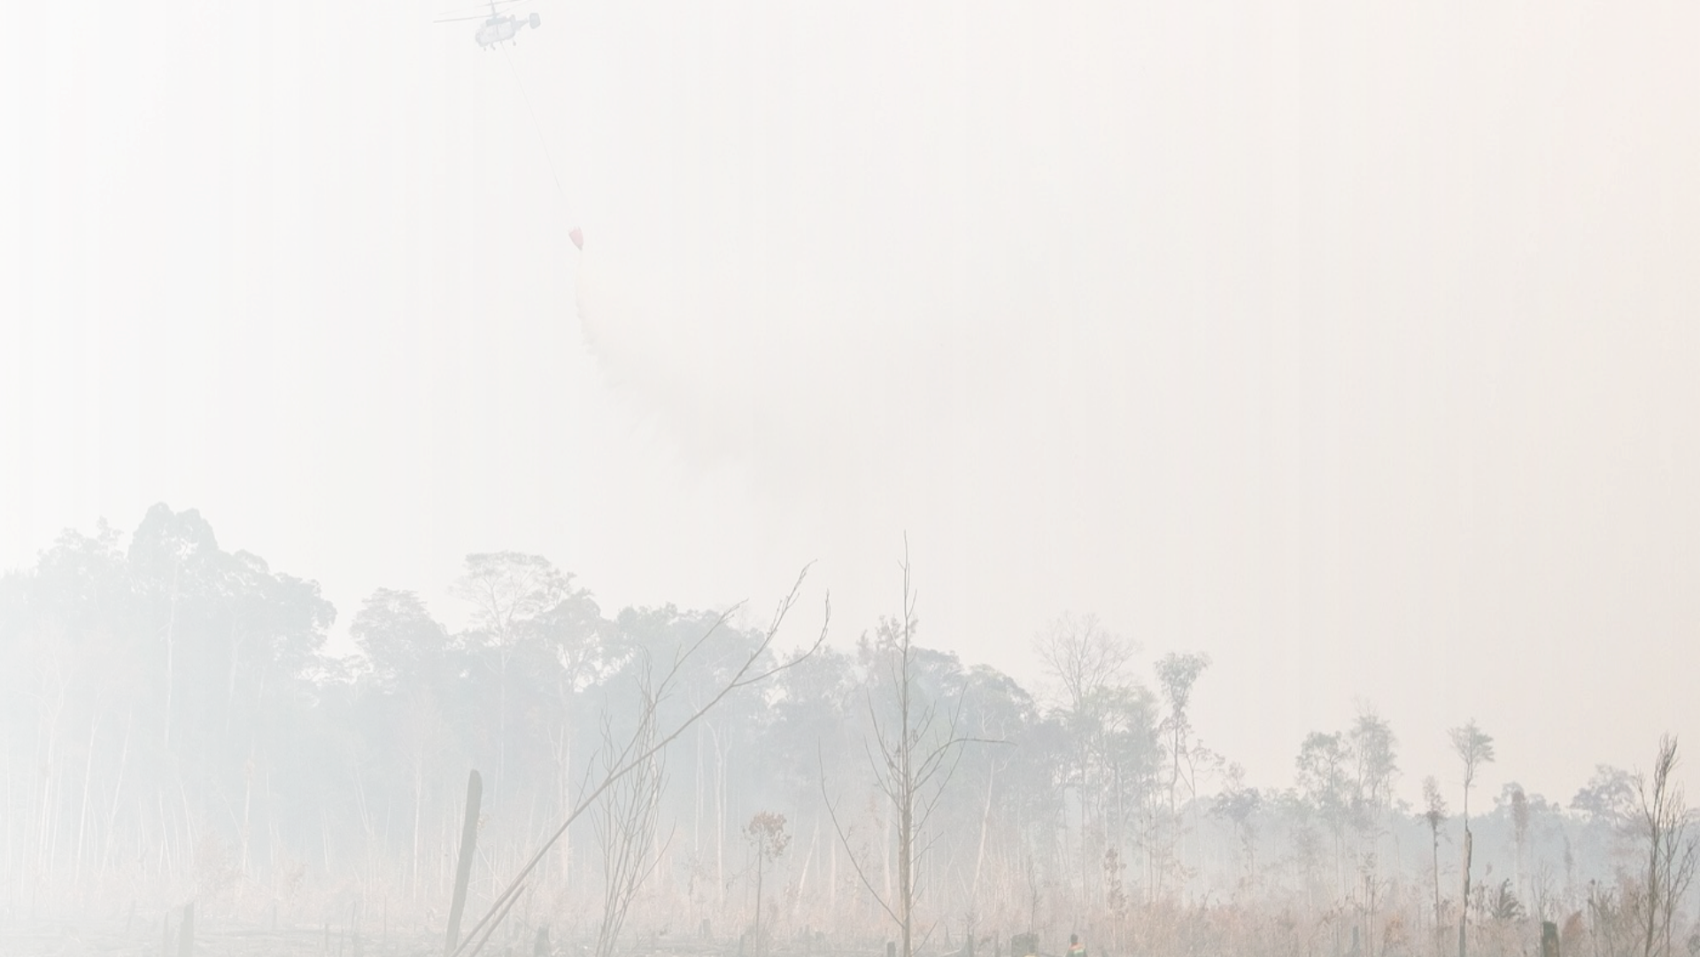
Thank you
National Disaster Management Agency (BNPB)
Meeting with the Ambassador of Australia and NSW RFS, Monday 26 October 2026
Photo: DenY Krisbiyantoro, CC BY-SA 4.0, Wikimedia Commons

